Slide 1
DBS – HACKO-HIRE 2022
ONLINE BOOK ORDER SYSTEM
Batch-20
https://github.com/manikantapabba/dbsproject.git

Slide 2
MODULES
Objective
Tools and Technologies
Modules
Snapshots
Conclusion

Slide 3
objective
To develop online portal to buy stocks which includes 2 modules 1. Customer, 2. Admin
Customer can buy stocks under price limit of mentioned price and order executes when the requirements satisfy
Admin will control the market can add status like open, close market status and modify stock prices

Slide 4
Tools and technologies
VS Code Editor
Python – Django
Postgresql – Database
Pgadmin – Database explorer
HTML, CSS,JavaScript

Slide 5
modules
Customer
Admin

Slide 6
Customer
Customer can see
Stock list along with price as drop down
Customer can mention limit for stock price
Customer can see success and failure messages according to flags

Slide 7
admin
Admin can control
Market status
Execute orders
Modify stock details

Slide 8
Conclusion
Developed an Web Portal using Django, Postgresql for ordering stock under price limit, Admin has access can see the all trade lists with all error and successful logs

Slide 9
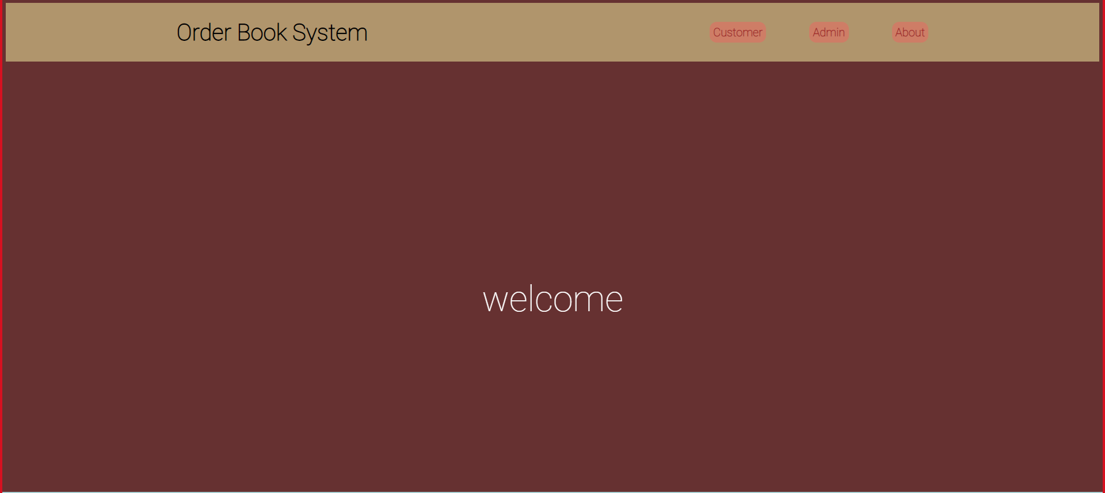

Slide 10
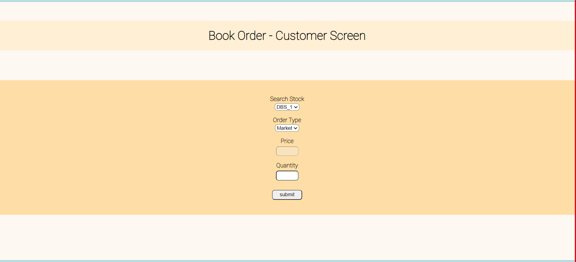

Slide 11
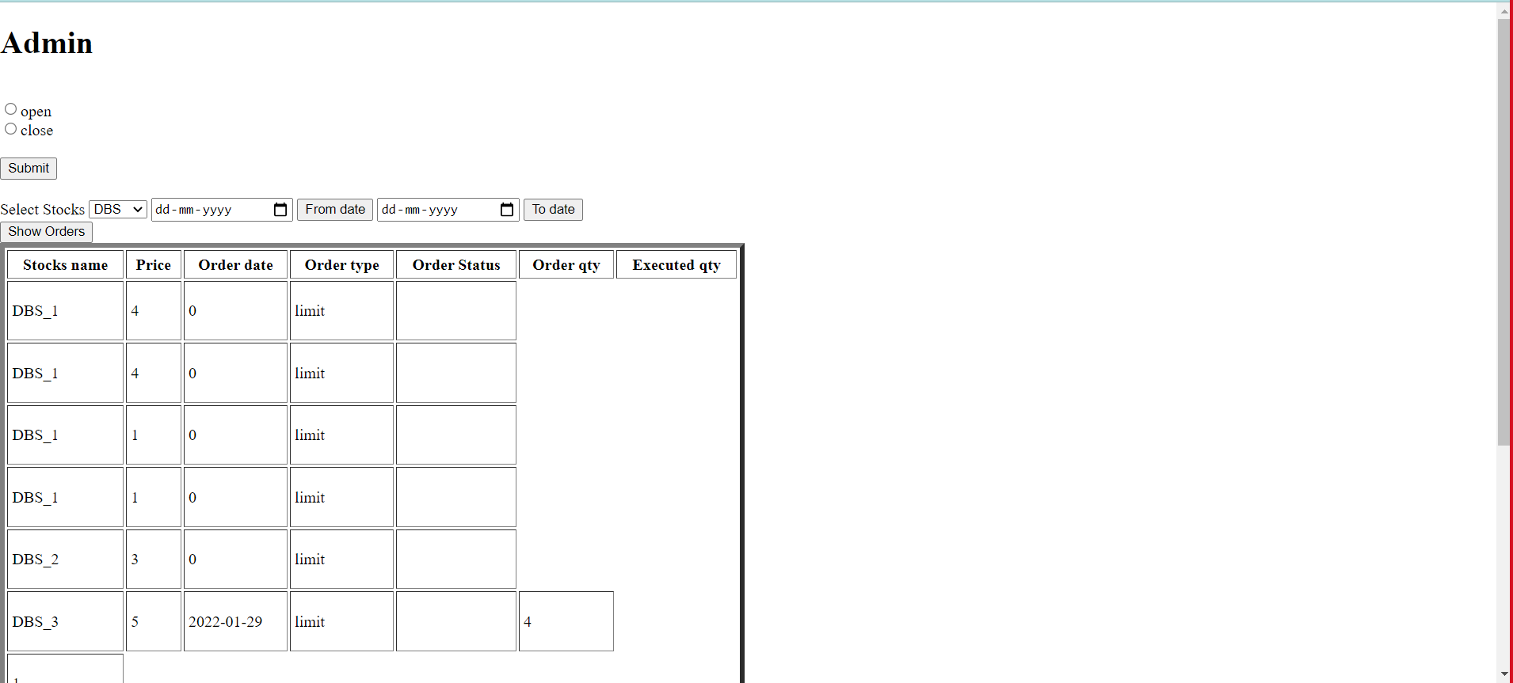

Slide 12
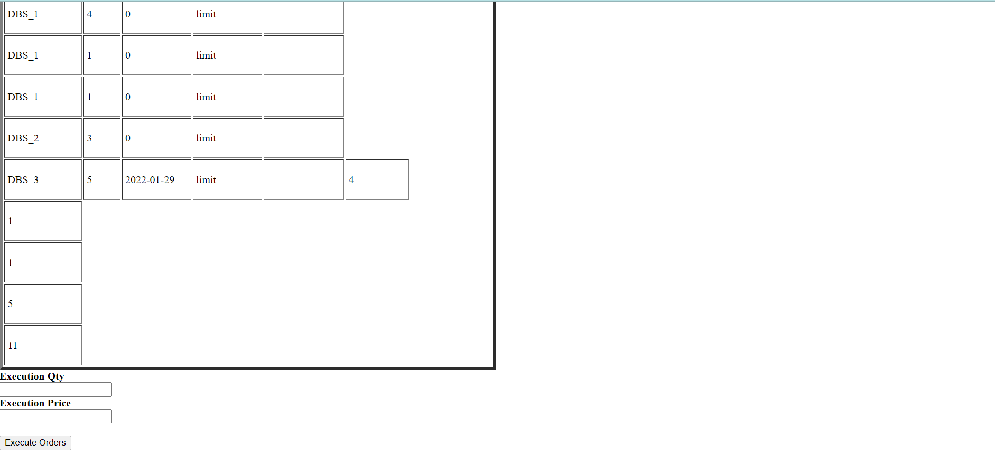

Slide 13
